Slide 1
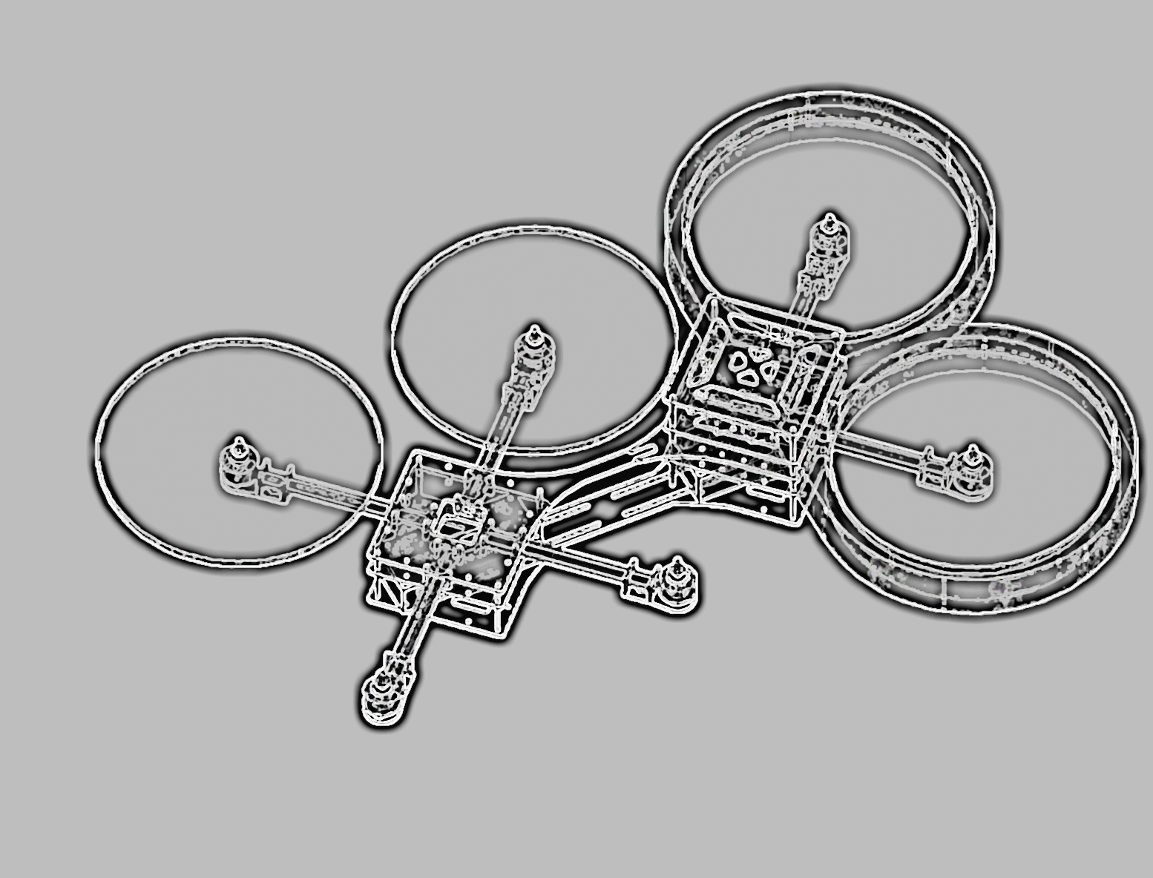
Integrated Project
X-COPTER

Slide 2

The X-Copter Project: Introduction
University of
Applied Sciences
Topic
TEXTtextTEXT

Slide 3
The X-Copter Project: Table of Content
University of
Applied Sciences
Table of Content
Project Management
System Architecture
Hardware
Linux
Flight Controller
Conclusion
Challenges
Lessons Learned

Slide 4
The X-Copter Project: Table of Content
University of
Applied Sciences
Table of Content
Project Management
System Architecture
Hardware
Linux
Flight Controller
Conclusion
Challenges
Lessons Learned

Slide 5
The X-Copter Project: Table of Content
University of
Applied Sciences
Table of Content
Project Management
System Architecture
Hardware
Linux
Flight Controller
Conclusion
Challenges
Lessons Learned

Slide 6
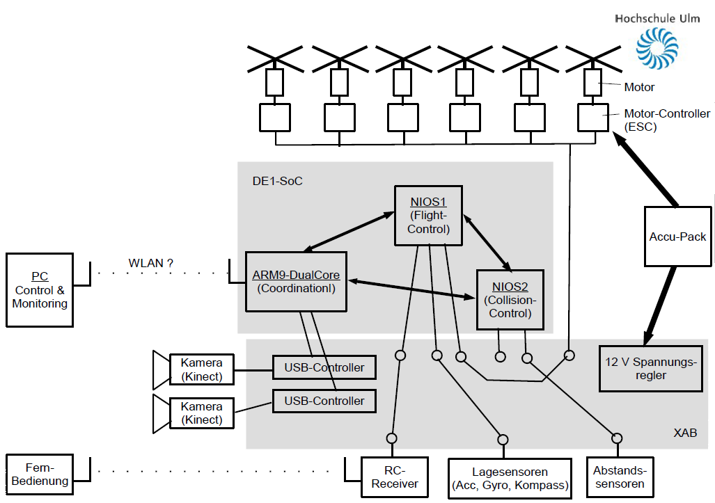
Old System Architecture

Slide 7
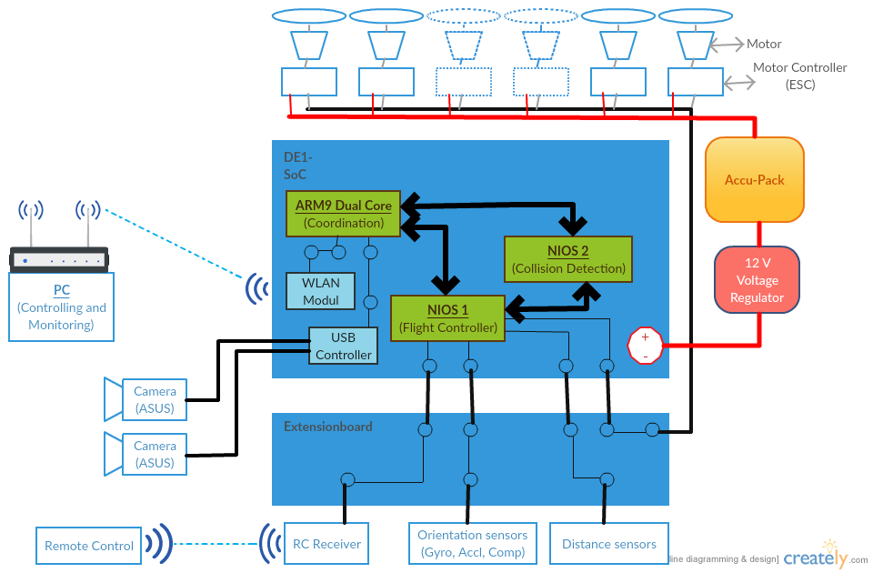
New System Architecture

Slide 8
The X-Copter Project: Table of Content
University of
Applied Sciences
Table of Content
Project Management
System Architecture
Hardware
Linux
Flight Controller
Conclusion
Challenges
Lessons Learned

Slide 9
The X-Copter Project: Table of Content
University of
Applied Sciences
Table of Content
Project Management
System Architecture
Hardware
Linux
Flight Controller
Conclusion
Challenges
Lessons Learned

Slide 10
The X-Copter Project: Linux
University of
Applied Sciences
Buildroot
TEXTtextTEXT

Slide 11
The X-Copter Project: Linux
University of
Applied Sciences
Wi-Fi
TEXTtextTEXT

Slide 12
The X-Copter Project: Linux
University of
Applied Sciences
MCAPI
TEXTtextTEXT

Slide 13
The X-Copter Project: Linux
University of
Applied Sciences
MAVLink
TEXTtextTEXT

Slide 14
The X-Copter Project: Table of Content
University of
Applied Sciences
Table of Content
Project Management
System Architecture
Hardware
Linux
Flight Controller
Conclusion
Challenges
Lessons Learned

Slide 15
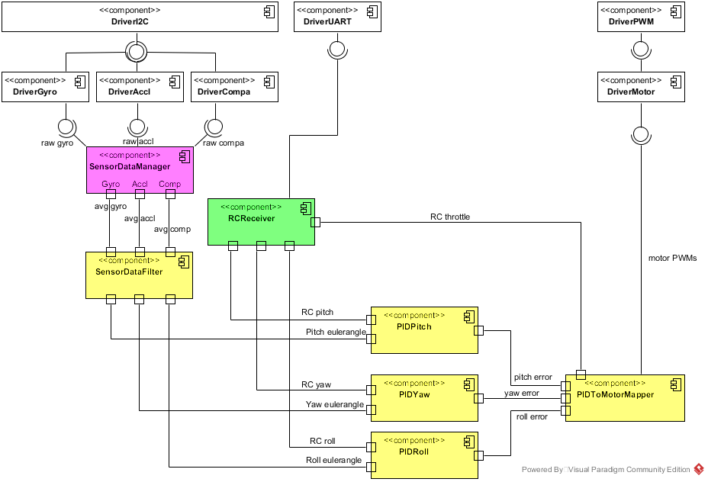
Flight Controller System Architecture

Slide 16
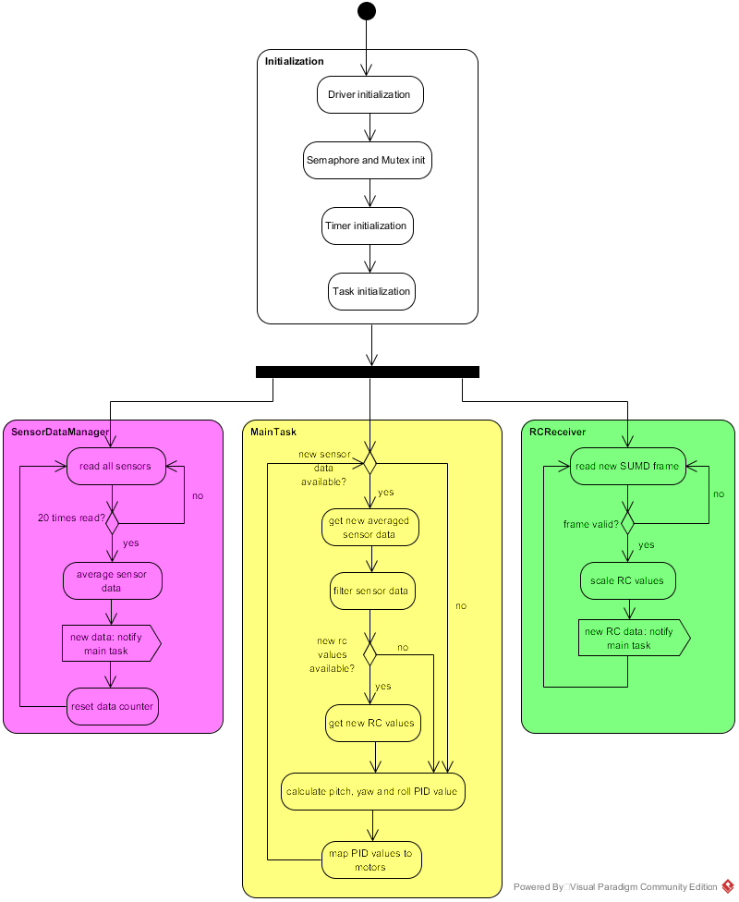
Flight Controller Program Flow

Slide 17
The X-Copter Project: Table of Content
University of
Applied Sciences
Table of Content
Project Management
System Architecture
Hardware
Linux
Flight Controller
Conclusion
Challenges
Lessons Learned

Slide 18
The X-Copter Project: Table of Content
University of
Applied Sciences
Table of Content
Project Management
System Architecture
Hardware
Linux
Flight Controller
Conclusion
Challenges
Lessons Learned

Slide 19
The X-Copter Project: Table of Content
University of
Applied Sciences
Table of Content
Project Management
System Architecture
Hardware
Linux
Flight Controller
Conclusion
Challenges
Lessons Learned

Slide 20
The X-Copter Project: Topic
University of
Applied Sciences
Topic
TEXTtextTEXT

